Slide 2
Cascade

Slide 3
Strategies utilized
Designated VL monitor for calling
On site centrifuge/lab refrigerator
Multiple lab personnel/staff doubling
Three major testing days (however daily testing facilitated)
Consistent and continuous Monitoring & Evaluation
Sensitization of staff to identify clients
- prescription,
- psychosocial visits
Medical Field visits
Continuous health literacy- VL monitor & at point where bloods are done
Combined clinic and lab appointments

Slide 4
Tools utilized In vl uptake process
Monthly cleaned VL eligibility listing (TSIS2 Data and CHARES log form used to clean)
Viral Load Monitoring/Appointment Book
CHARES internal log form
CHARES appointment card
Notation made in docket by VL monitor (CHARES nurse)

Slide 5
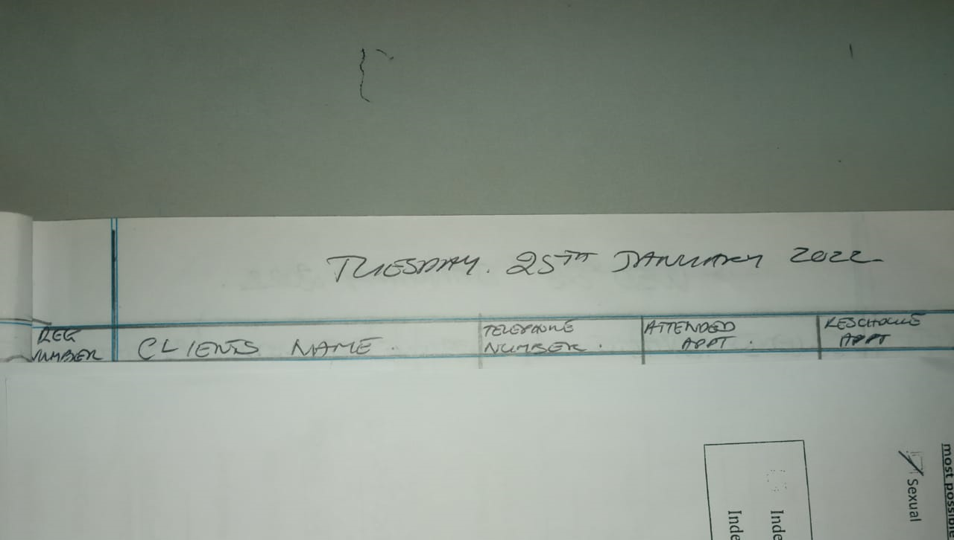
Example of Viral Load Appointment Tool

Slide 6
Example of CHARES log form

Slide 7
Notation made in docket by VL monitor

Slide 8
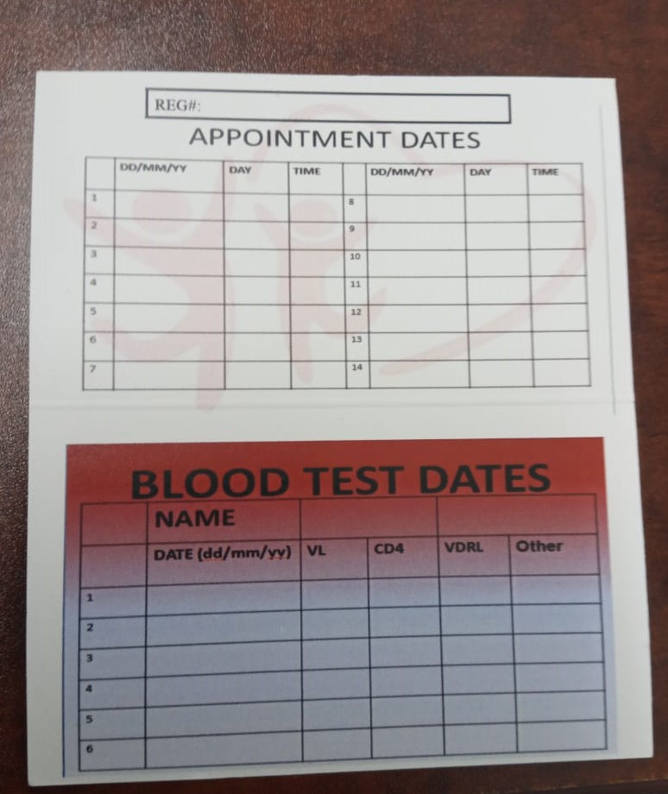
Appointment card

Slide 9
Viral Load Uptake-process
VL eligibility list generated by M&E officer last week of month
Patients called & scheduled for 1st two weeks of month
Reminder calls done day prior to appointment
Cleaned list provided to VL monitor
When VL done, recorded on log form
If missed, rescheduled to last two weeks of the month
At end of month VL monitor provided M& E officer with updated list
Clients who missed schedule for 1st two weeks of upcoming month

Slide 10
Best Practices
Utilization of staff to assist in taking bloods (doctors, peer navigator)
Expanded testing days
Increased staff trained on centrifuge use ( 5 persons currently trained)
Provision of labs on medical field visits
Staff willingness/dedication
Teamwork

Slide 11
Lessons Learnt
Staff own the project (staff buy in)
Multiple areas for contact information to be updated
Phlebotomist checks registration numbers on TSIS to reduce errors/rejection of samples.

Slide 12
Steps taken to implement this VL uptake process
Team members sensitized on changes in VL uptake process through pre-planning meetings
In depth team meeting held with persons who would be integral to this process
Frequent reviews of the process held throughout the initial 3 month trial period

Slide 13
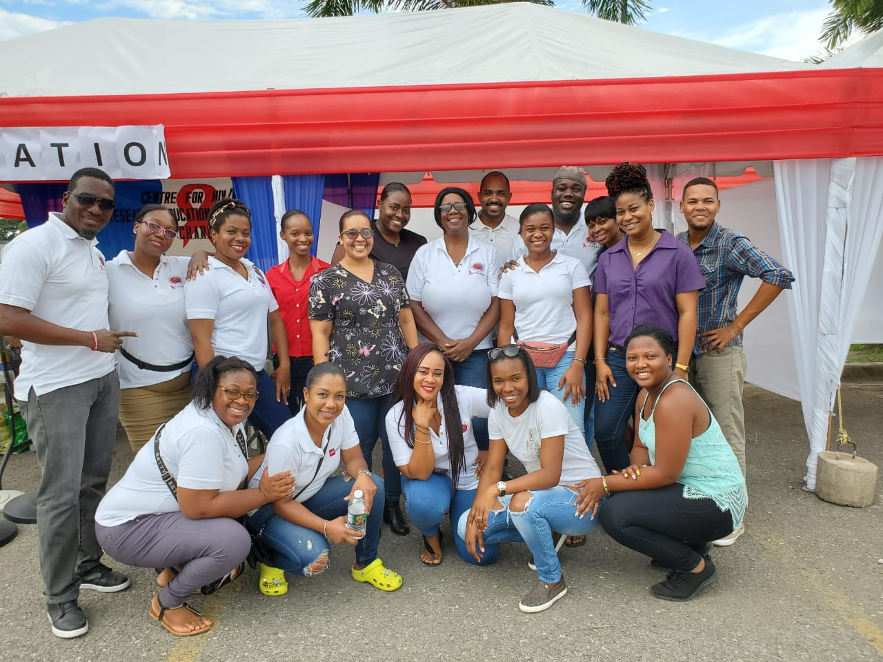
TEAM CHARES

